Slide 1

ChatSonic
Group 9:
Abdulrahman Almyman–
Waleed Alnajashi–

Slide 2

Introduction
What is ChatSonic ?
ChatSonic is an AI-powered chatbot platform from Writesonic that simplifies communication boosts productivity and helps you stay organized like ChatGPT, it was founded in october 2020 by Samanyou Garg and it has its headquarters in San Francisco, USA .

Slide 3

Company and founders
Writesonic is an AI-powered writing assistant platform founded by Samanyou Garg in 2020 [2]. Samanyou is an entrepreneur with a passion for solving complex real-world problems using AI. He is also the CEO of Writesonic. In October 2020, Sam created an AI-powered landing page generator to help create great copy for his digital products. In January 2021, Writesonic launched its AI Article/Blog Writer, which generated a full-length article with the input of a few words. This feature became the most popular and was named "Best AI writer of 2021" by TechRadar. The award has since been extended to "Best AI writer of 2022." The company plans to continue building a comprehensive platform to help people write with confidence and achieve their goals.

Slide 4
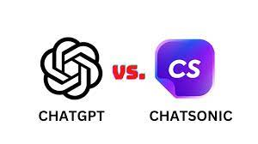
ChatSonic vs ChatGpt :
ChatGPT is restricted by the inputs or training data (up till 2021) that cannot be updated as regularly. On the other hand, Chatsonic is a more advanced and powerful version that can keep up with current news and events, granting it an advantage in terms of precision and dependability.[1]

Slide 5
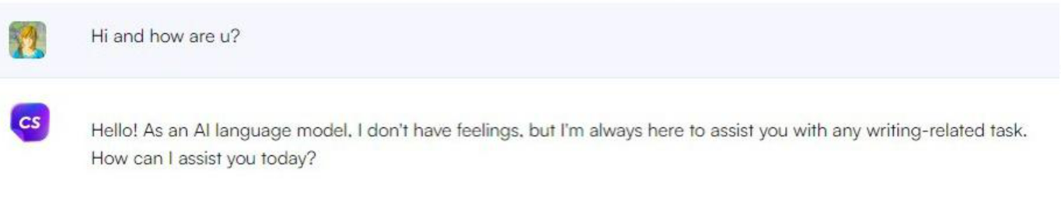
Testing the product

Slide 6
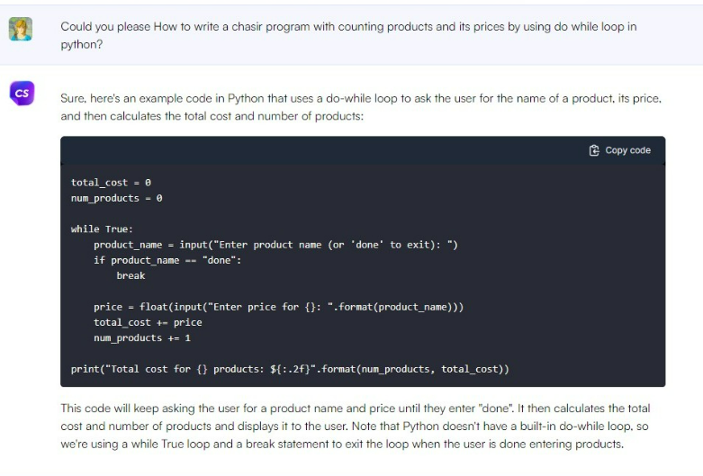
Testing the product:

Slide 7
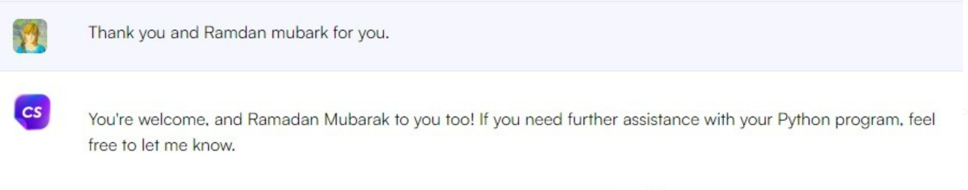
Testing the product:

Slide 8

Revenue (2021):
In 2021 Chatsonic generated $1M in revenue.

Slide 9
Revenue (2022-2025):
Chatsonic is expected to generate $1M – $2M in 2025

Slide 10

The technical principle of Chatsonic:
The Technical Principle of Chatsonic: is powered by a sophisticated machine learning model based on neural networks which enables it to simulate human speech. It has integration with Stable Diffusion and DALL-E for image generation, and a powerful connection with Google search that helps to come up with hyper-relevant content. ChatSonic uses natural language processing technology to answer your questions accurately and informatively.

Slide 11

Competing products:
ChatGPT: ChatGPT is a popular AI writing tool that uses deep learning to generate natural language text .
OpenAI Playground: OpenAI Playground is an open-source platform that allows developers to build and train AI models.
Google's Bard: Google's Bard is an AI language model that can write poetry.

Slide 12
References:
Samanyou Garg - Founder and CEO - Writesonic (YC S21)
Samanyou Garg - Founder and CEO @ Writesonic
About Writesonic | We Help You Scale Content Production
https://writesonic.com/compare/chatsonic-vs-chatgpt

Slide 13
Thank you for listening
Abdulrahman Almyman
Waleed Alnajashi

